Slide 1
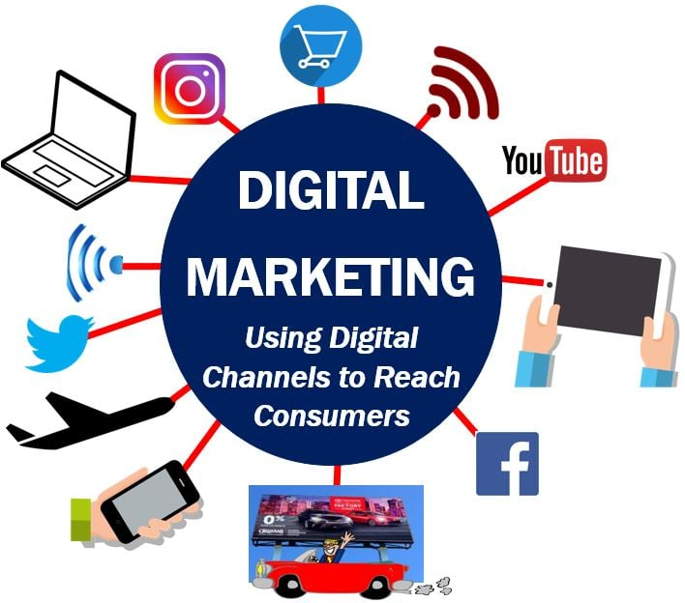
DIGITAL MARKETING PROJECT PHASE 2☺:-
TEAM LEADER:-Yerra kavya
Team members:-
Putta sowjanya
Vajja kavyanjali
Nimmaka usharani
Pathivada renuka

Slide 2
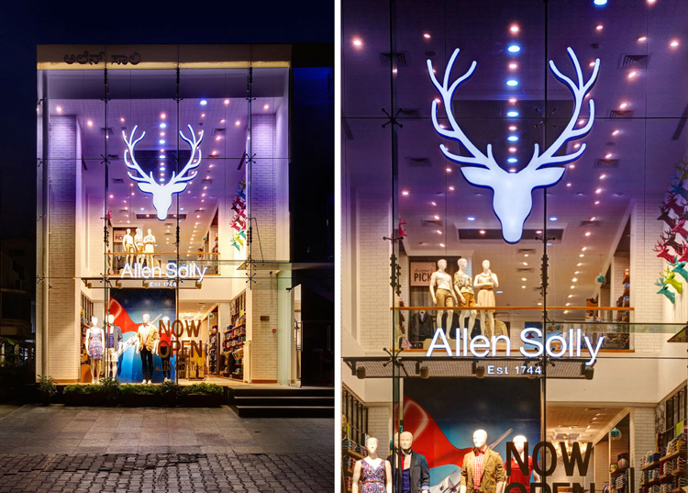
ALLEN SOLLY:-

Slide 3
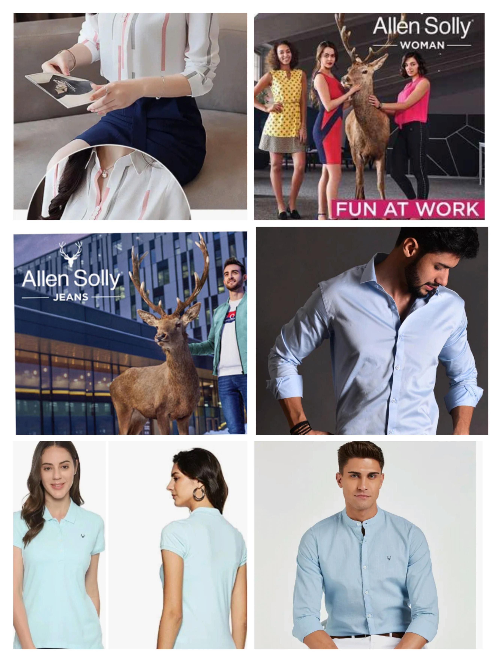
PART 1:-Brand study, Competitor Analysis & Buyer’s/Audience’s
PART 1:-Bran Study, Competitor Analysis & Buyer’s/Audience’s
persona
*Research Brand:-ALLEN SOLLY
Allen Solly was founded in 1744 by William Hollin and Co Ltd. The brand was bought within the 90’s by a firm called Madura Garments. Madura Garments was an element of Madura coats and a big producer of threads. Aditya Birla Group acquired Allen Solly in 2001.
*MISSION/VALUES:Allen Solly is a premium clothing brand
from the house of Aditya Birla owned Madura Fashion and Lifestyle.
It was introduced in
India in 1993 as a Friday Dressing brand.

Slide 4
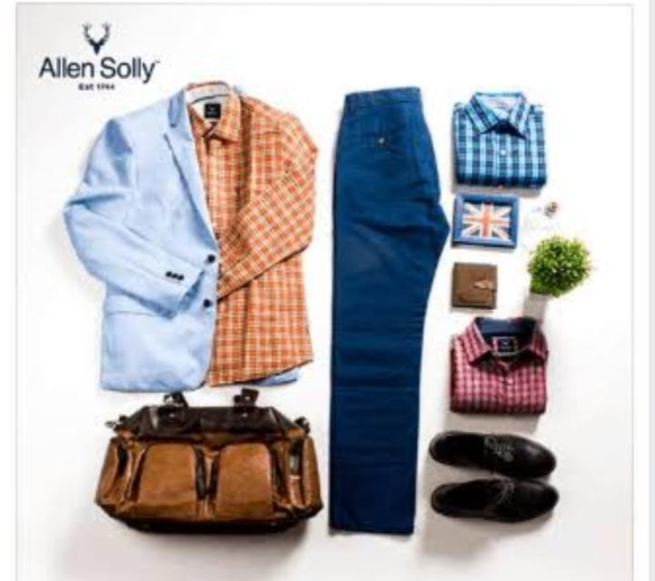
Brand study of Allen Solly☺:-
Allen Solly is a well-known Indian fashion brand under Aditya Birla Fashion and Retail Limited. It’s known for its casual and formal clothing lines. The brand was established in 1993 and is known for introducing the concept of “Friday Dressing” in India, promoting a more relaxed dress code for the workplace. They offer a wide range of clothing, including shirts, trousers, dresses, and accessories, targeting the urban, fashion-conscious consumer. Their products are often characterized by vibrant colors and contemporary designs. Please let me know if you’d like more specific information about the brand or any particular aspect of it.

Slide 5
USP:-
The USP (Unique Selling Proposition) of Allen Solly’s a well-known
clothing brand, is its casual and
stylish approach to workwear It’s known for blending
formal and casual elements to create a re
yet professional look. Allen Solly’s key features
often include vibrant colors,innovative designs,and a
comfortable fit, making it a popular those who want to
balance fashion and profession
in their attire.

Slide 6
Analyze brand tone and Identity:-
Madura Fashions promoted menswear brand Allen Solly launched its new brand identity hoping to give the brand a ‘contemporary’ image and increase sales. As its new brand mark, Allen Solly has adopted a contemporary version of the Stag
Set 5 SMART goals and KPIs for the same:-
Sales Growth: Increase sales by 15% in the next fiscal year by expanding into new markets and enhancing the online shopping experience. Customer Engagement: Improve customer satisfaction by achieving a Net Promoter Score (NPS) of 70 or higher within the next six months through better customer support and feedback integration. KPIs:-Key Performance Indicators (KPIs) for a brand like Allen Solly, which is a well-known clothing and fashion company, might include the following Sales Revenue: Monitoring the total sales revenue can provide a clear picture of the brand’s financial health and growth. Same-Store Sales Growth: This KPI measures the revenue growth in existing stores, indicating whether the brand is attracting more customers or increasing sales in its current locations.

Slide 7
Part1:-Brand study, Competitor Analysis & Buyer’s/Audience’s Persona
Buyer’s/Audience’s persona:-
The buyer’s audience persona for Allen Solly, a clothing brand, typically includes individuals who are fashion-conscious, seeking trendy and comfortable clothing. They may be:
Demographic:
Age: Primarily young adults and working professionals, but also caters to a wide age range. Gender: Both men and women. Income: Middle to upper-middle-class consumers.
Geographic:-- Primarily urban and semi-urban areas. Needs:-- Trendy, well-fitted, and comfortable clothing for various occasions.

Slide 8
PART 1:- Brand study, Competitor Analysis & Buyer’s Audience’s persona
Competitor Analysis:-
Allen Solly is a well-known clothing brand under Aditya Birla Fashion and Retail Limited. To perform a competitor analysis for Allen Solly, you should consider other brands in the same market segment, which includes casual and formal clothing for men and women. Some key competitors might include:
Competitor:-1)Van Heusen
Competitor:-2)Arrow Competitor:-3)Raymond Competitor:-4)Peter England Competitor:-5)Louis Philippe

Slide 9
PART2:-SEO& Keyword Research
SEO Audit:-Influences in customer buying decision
Customer buying Devision
Customer perception for Brand sustainability
Keyword Research :-
Allen Solly uses- Informational, Navigational, Commercial & Transactional keywords to seek higher organic traffic. They use 97.9% of branded traffic and 2.1% of non-branded traffic.
*on page optimization:--
Page optimization for a brand like Allen Solly typically involves several key elements: 1)Keyword Research: Identify relevant keywords related to Allen Solly’s products and brand.
2)Content Quality: Ensure that the content on the page is high-quality, informative, and engaging.
3)On-Page SEO Elements: Optimize title tags, meta descriptions, header tags (H1, H2, etc.), and image alt tags with relevant keywords.

Slide 10
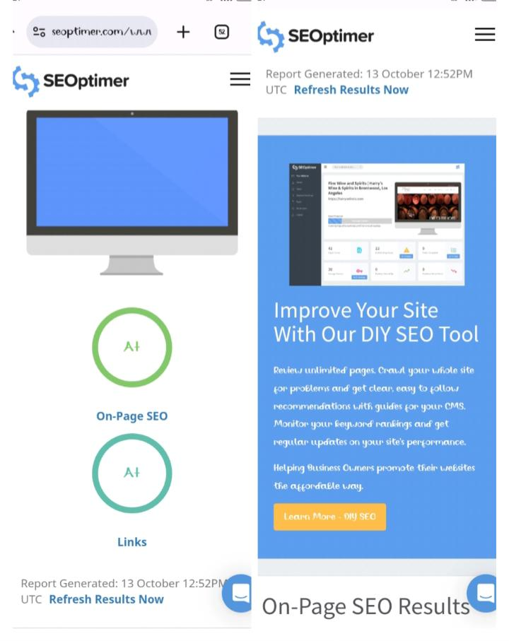
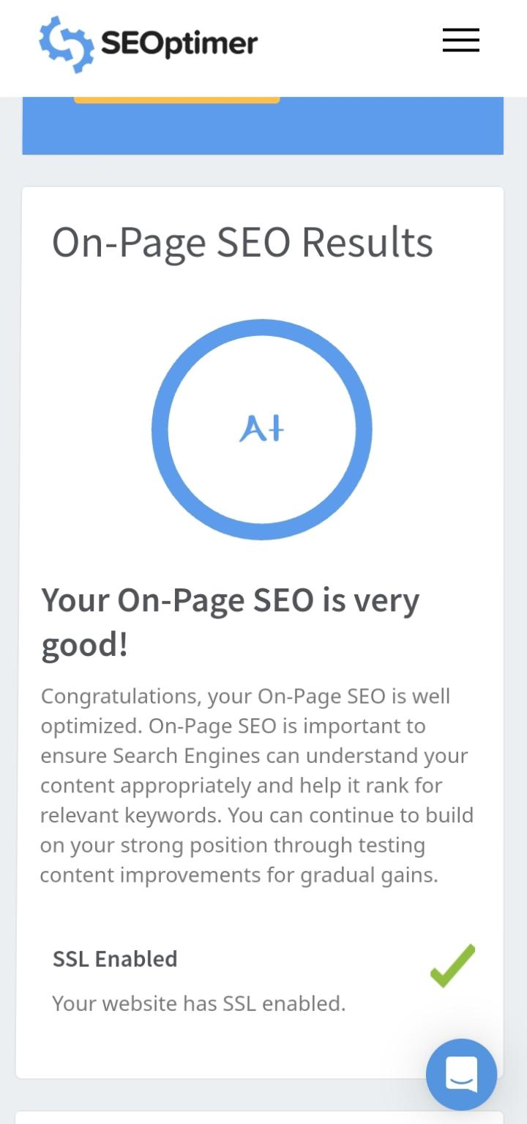
On-page SEO result☺:-

Slide 11
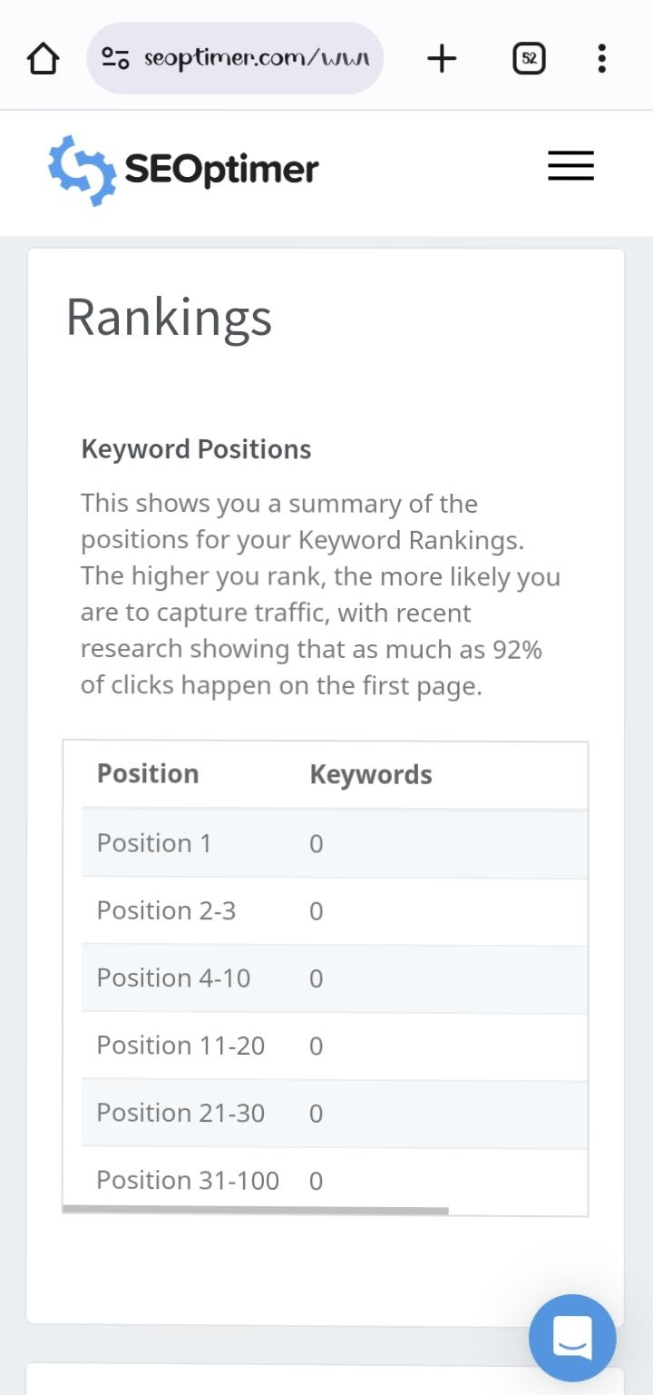
RANKING☺:-

Slide 12
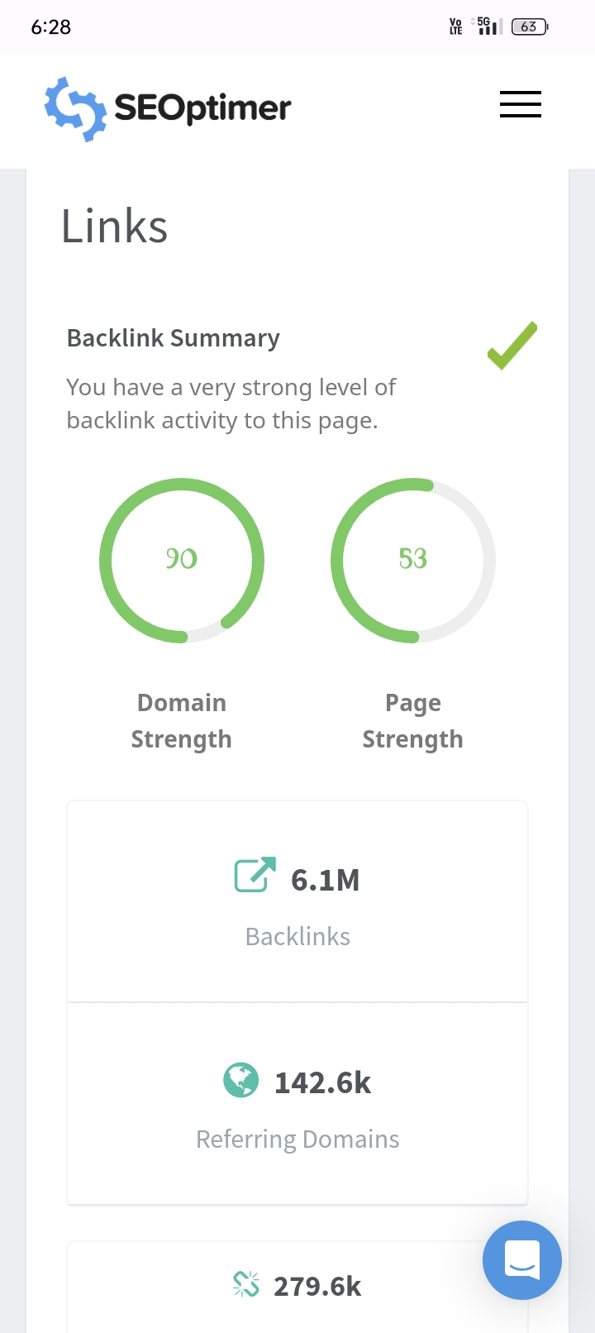
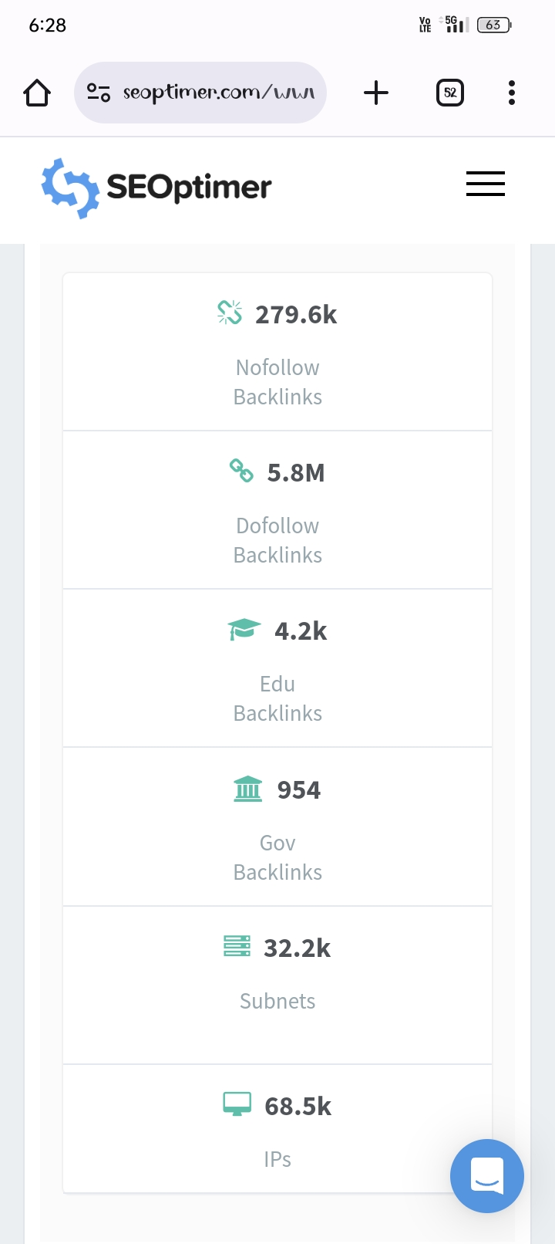
LINKS☺:-

Slide 13
PART3:-Content ideas and marketing strategies
Content ideas generation & Strategy:-
Generating content ideas and developing a content strategy for a brand like Allen Solly, which is known for its fashionable clothing, can be a dynamic process. Here are some content ideas and a strategy to consider:
Content Ideas
2)Seasonal Lookbooks:-Create seasonal lookbooks showcasing the latest collections, complete with stylish outfit ideas. 2) Fashion Tips and Guides:- Share fashion tips, guides, and how-to articles on topics like “How to Dress for Success” or “Choosing the Right Outfit for Different Occasions.”

Slide 14

Marketing Strategies☺:-
Marketing Strategy of Allen Solly analyzes the brand with the marketing mix framework which covers the 4Ps (Product, Price, Place, Promotion).
These business strategies, based on Allen Solly marketing mix, help the brand succeed in the market.
Let us start the Allen Solly Marketing Strategy & Mix to understand its product, pricing, advertising & distribution strategies:
Quick Glance:
Product strategy
Pricing strategy
Place and Distribution strategy
Promotional and Advertising strategy

Slide 15
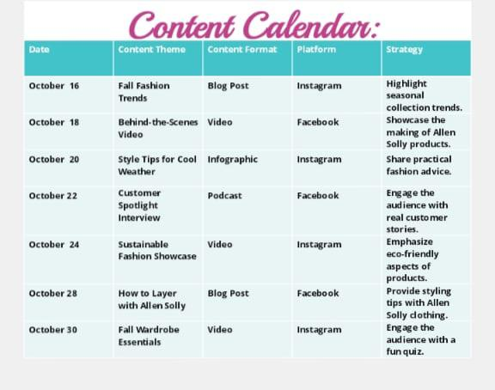
MARKETING STRATEGY:-ALLEN SOLLY
EXAMPLE☺:-

Slide 16
PART3:-Content ideas and marketing strategies
Contact Ideas:- Style Guides: Create style guides for different seasons, occasions, or fashion trends, showcasing how to incorporate Allen Solly’s clothing into various looks.
Customer Stories: Share customer testimonials and stories about their experiences with Allen Solly products.
Marketing strategies:-
Social Media Marketing: Leverage platforms like Instagram, Facebook, and Pinterest to showcase visually appealing content and engage with your audience.
Email Marketing: Send personalized product recommendations, exclusive offers, and updates to your subscribers.
Content Marketing: Create a fashion blog on your website and regularly publish articles on fashion tips, trends, and style advice.

Slide 17
PART4:-Content Creation and Curation
Creating and curating content for a brand like Allen Solly, which is a well-known fashion and lifestyle brand, involves several key strategies:
Brand storytelling:- Craft compelling stories about the brand’s history, values, and unique selling points.
Product showcasing:-Regularly create content that showcases the latest Allen Solly collection mphasizing their unique features and how they fit into various lifestyles
Visual content:-High-quality images and videos are essential
Email marketing:-Email Marketing: Send out regular newsletters with updates on new collections, exclusive promotions, and styling tips.

Slide 18
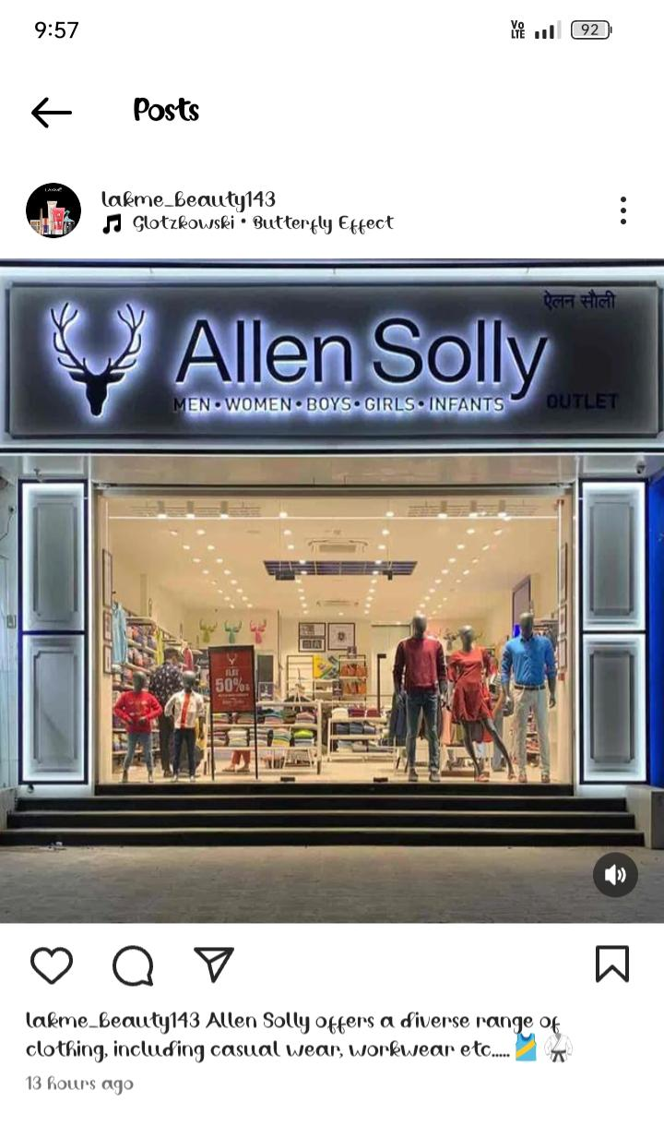
FARMAT 1☺:-
: Content Format 1:-Trendy Fashion Tips
Caption:- “Stay ahead of the fashion curve with Allen Solly! 🔥 Our style experts
are here to help you look your best. Want to know how to mix and match
your wardrobe for that perfect look? Drop your fashion questions below and
let’s chat! 💃🕺 #FashionTips #AllenSollyStyle CAS:- “Comment with your fashion dilemmas or questions, and we’ll provide personalized
styling tips just for you!”

Slide 19
FARMAT 2☺:-
Content Format 2:-Custimer Testimonials Captain:- “Our customers are our best brand ambassadors! ❤️ Meet Sarah, who fell in love with her recent Allen Solly purchase. Share your own #AllenSollyStory with us. We’d love to hear it! #HappyCustomers #Testimonials CAS:- “Share your Allen Solly experience in the comments, and you could be featured in our next testimonial post!”

Slide 20
FARMAT 3☺:-
Content FARMAT 3:-Flash sale Announcement Captain:- 🚨 “Exciting News! It’s time for an Allen Solly Flash Sale! Get your hands on the latest fashion trends at unbelievable prices. Don’t miss out! Visit our website now to grab your favorites. 🛍️💃 #FlashSale #ShopNow CAS:- “Tap the link in our bio or head to www.allensolly.com to start shopping now! Hurry, the best deals won’t last long!”

Slide 21
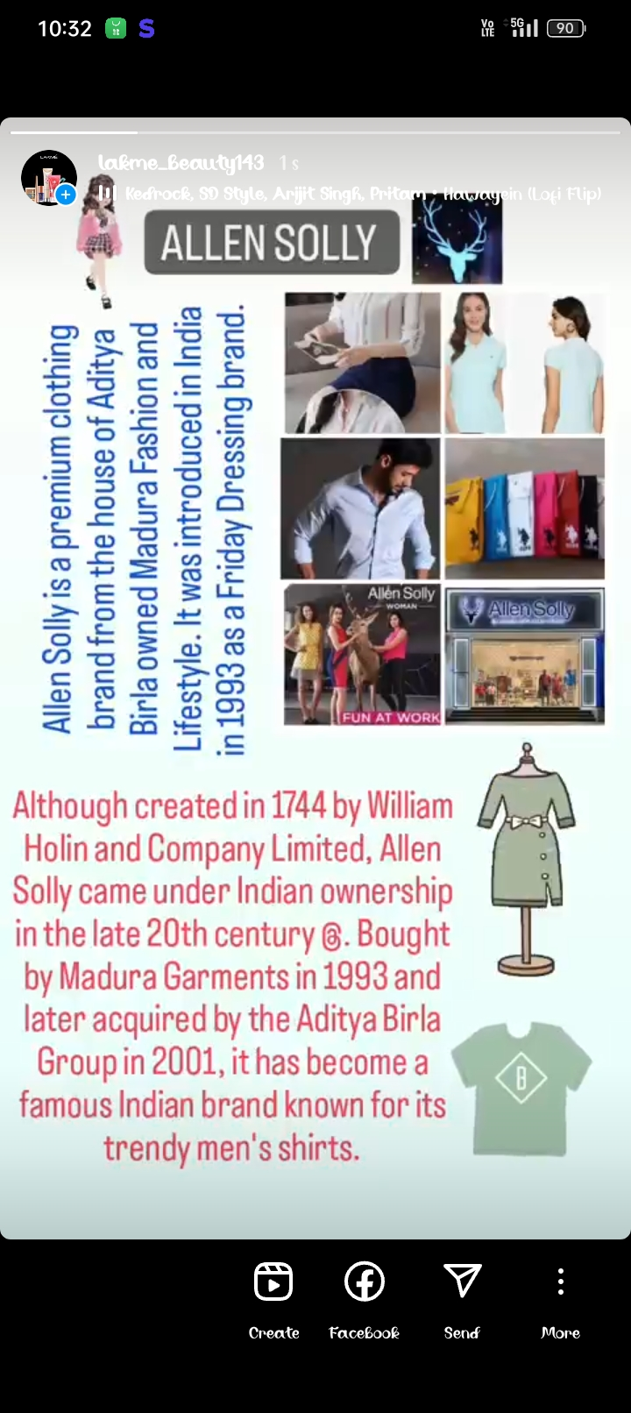
INSTAGRAM STORY☺:-
In 2001, the Aditya Birla company quickly acquired the ownership rights and established.
it as a well-known Indian brand.Aditya birla owned Allen Solly in 2001 making it an Indian brand which sells it product worldwide. Allen Solly is a pure Indian brand.
https://instagram.com/stories/lakme_beauty143/3212444927458161007?utm_source=ig_story_item_share&igshid=MTc4MmM1YmI2Ng==

Slide 22
Instagram Link:-
https://instagram.com/stories/lakme_beauty143/3212444927458161007?utm_source=ig_story_item_share&igshid=MTc4MmM1YmI2Ng==

Slide 23
DESIGN’S/VIDEO EDITING:-
We used the VN app for editing...

Slide 24


